Slide 1
Approximation Algorithms: Subset-sum
Session 25
Henry Lucky, S.Kom. M.Kom.

Slide 2
Outline Materials
Session 25
Exponential-time exact algorithm
Fully polynomial-time approximation scheme

Slide 3
Learning outcomes
25
LO 1: Explain fundamental concept of analysis algorithms
LO 2: Apply algorithm techniques and methods
LO 3: Solve a problem using specific algorithm.
LO 4: Compare several algorithm design methods

Slide 4
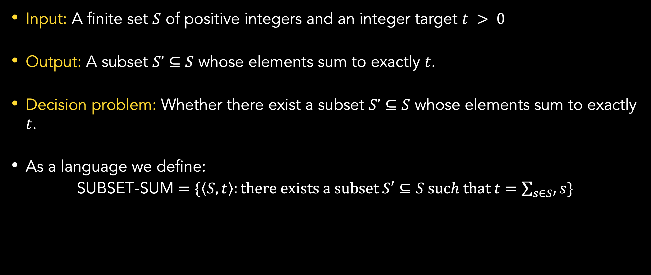
Introduction
Subset-sum problem
Input: A finite set $S$ of positive integers and an integer target $t > 0$
Output: A subset $S’⊆S$ whose elements sum to exactly $t$.
Decision problem: Whether there exist a subset $S’⊆S$ whose elements sum to exactly $t$.
As a language we define:
SUBSET-SUM $=\{\left\langle S, t\right\rangle :there exists a subset S′⊆S such that t=\sum_{s∈S′}{s}\}$

Slide 5
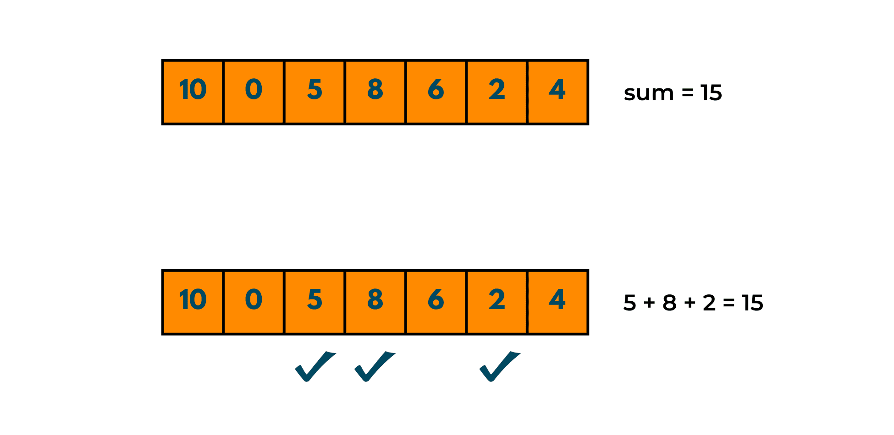

Introduction
Subset-sum problem
Here is an example input $S=\{10, 0, 5, 8, 6, 2, 4\}$and $t=15$
One of the possible solution is $S^{′}=\{5, 8, 2\}$
Are there any other solutions?

Slide 6
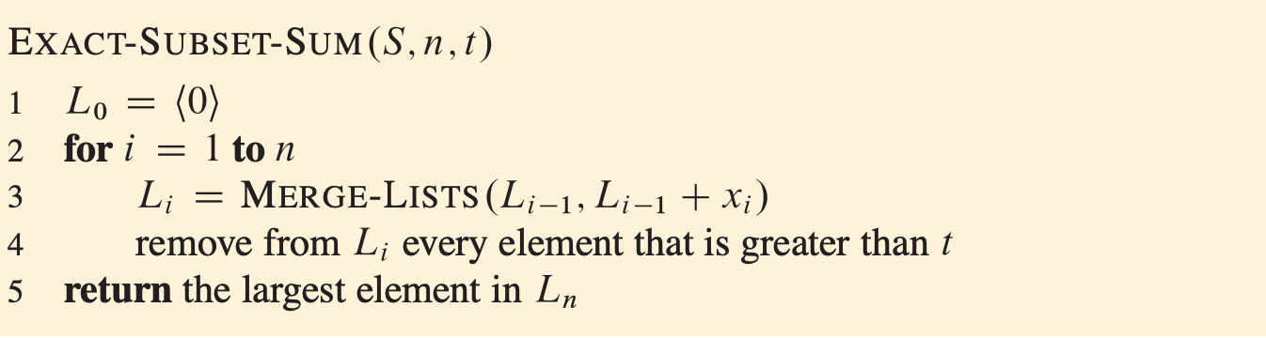

Exponential time exact algorithm
Subset-sum problem
Some preliminaries
we use the notation $S + x = \{ s+x: s∈S\}$
we have a merge lists algorithm that runs in time proportional to the sum of the lengths of the two lists.
MERGE-LIST produces sorted lists with duplicate value removed

Slide 7
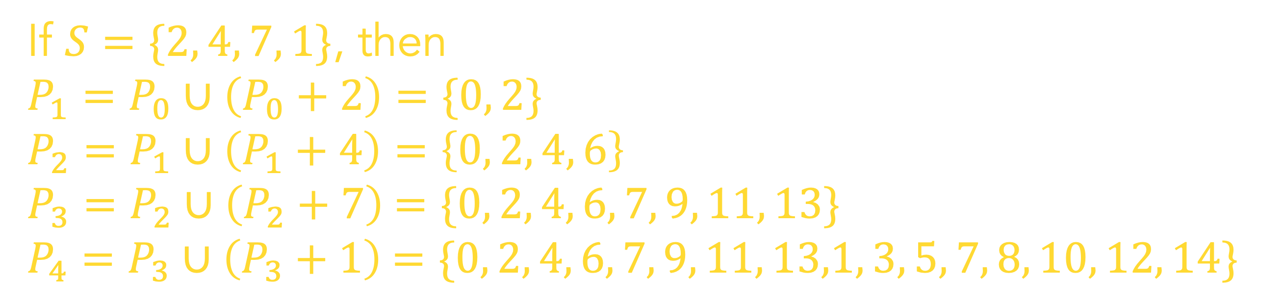

Exponential time exact algorithm
Why it works?
Some notation
$P_{i}$ is the set of sums of all subsets of values up to $x_{i}$
it can be shown that $P_{i}=P_{i−1}∪(P_{i−1}+x_{i})$
If $S=\{2, 4, 7, 1\}$, then
$$P_{1}=P_{0}∪\left(P_{0}+2\right)=\{0, 2\}$$
$$P_{2}=P_{1}∪\left(P_{1}+4\right)=\left\{0, 2, 4, 6\right\}$$
$P_{3}=P_{2}∪\left(P_{2}+7\right)$ $=\{0, 2, 4, 6, 7, 9, 11, 13\}$
$P_{4}=P_{3}∪\left(P_{3}+1\right)$ $=\{0, 2, 4, 6, 7, 9, 11, 13,1, 3, 5, 7, 8, 10, 12, 14\}$

Slide 8

Exponential time exact algorithm
Why it works?
Proof and complexity
by induction on i, it can be shown that $L_{i}$ is a sorted list that contains every element of $P_{i}≤t$
since $L_{i}$ can be as long as $2^{i}$, the algorithm, in general, is exponential

Slide 9

Exponential time exact algorithm
How it works?
Given 𝑡=15 and $S=\{10, 0, 5, 8, 6, 2\}$, then
$L_{1}=L_{0}∪\left(L_{0}+10\right)=\{0, 10\}$
$L_{2}=L_{1}∪\left(L_{1}+0\right)=\left\{0, 10, 0, 10\right\}=\left\{0, 10\right\}$
$L_{3}=L_{2}∪\left(L_{2}+5\right)$ $=\left\{0, 10, 5, 15\right\}=\{0, 5, 10, 15\}$
$L_{4}=L_{3}∪\left(L_{3}+8\right)$ $=\left\{0, 5, 10, 15, 8, 13, 18, 23\right\}=\left\{0, 5, 8, 10, 13, 15, 18, 23\right\}=\left\{0, 5, 8, 10, 13, 15\right\}$
$L_{5}=L_{4}∪\left(L_{4}+6\right)=$ $\left\{0, 5, 8, 10, 13, 15, 6, 11, 14, 16, 19, 21\right\}=\left\{0, 5, 8, 10, 11, 13, 14, 15, 16, 19, 21\right\}=\{0, 5, 8, 10, 11, 13, 14, 15\}$
$L_{6}=L_{5}∪\left(L_{5}+2\right)$ $=\left\{0, 5, 8, 10, 11, 13, 14, 15,2, 7, 10, 12, 13, 15, 16, 17\right\}=$ $\left\{0, 2, 5, 7, 8, 10, 11, 12, 13, 14, 15, 16, 17\right\}=\left\{0, 2, 5, 7, 8, 10, 11, 12, 13, 14, 15\right\}$
Return the largest element, which is 15. So, the answer to the decision problem is yes.

Slide 10
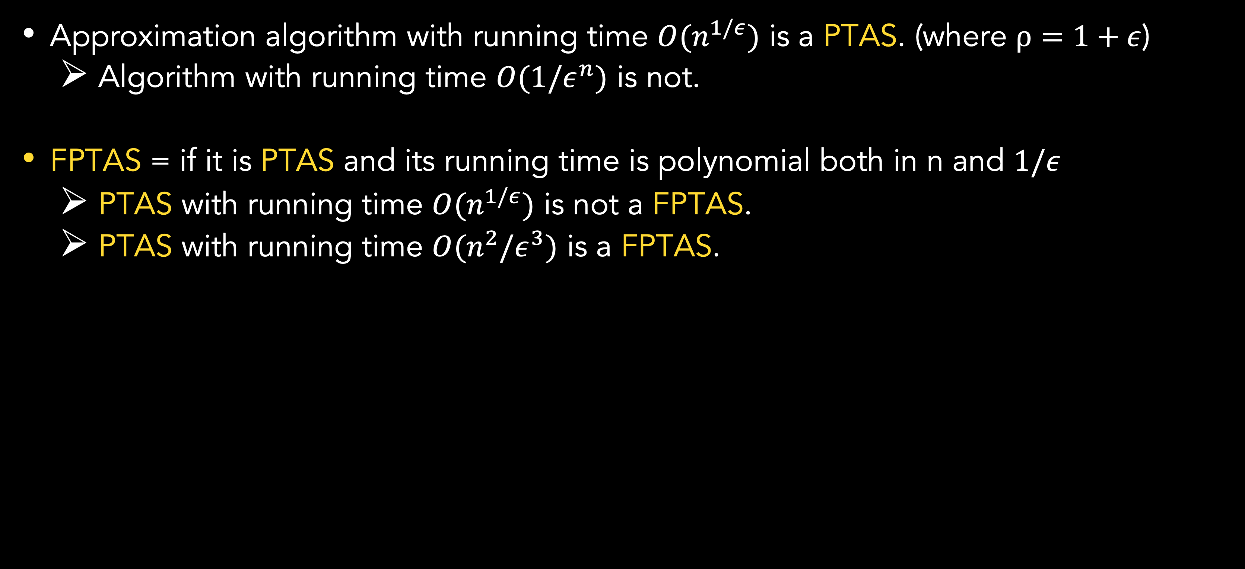
Fully polynomial-time approximation scheme
definition
Approximation algorithm with running time $Ο(n^{1/ε})$ is a PTAS. (where $ρ=1+ε$)
Algorithm with running time $Ο({1/ε}^{n})$ is not.
FPTAS = if it is PTAS and its running time is polynomial both in n and $1/ε$
PTAS with running time $Ο(n^{1/ε})$ is not a FPTAS.
PTAS with running time $Ο(n^{2}/ε^{3})$ is a FPTAS.
Notes:
PTAS = polynomial-time approximation scheme
FPTAS = fully polynomial-time approximation scheme

Slide 11
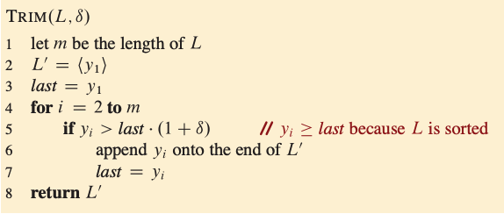



Fully polynomial-time approximation scheme
Subet-sum: Trimming the list
To trim by a factor $δ$ means every element y will be removed and then approximated (represented) by element z, given that z is no greater than y and also within a factor of $1+δ$ of y, so that:
$$\frac{y}{1+δ}≤z≤y$$
For example, if $δ=0.1$ and
$$L=(10, 11, 12, 15, 20, 21, 22, 23, 24, 29)$$
Then, we can trim L to obtain
$$L^{′}=(10, 12, 15, 20, 23, 29)$$
The complexity is $Θ(m)$

Slide 12
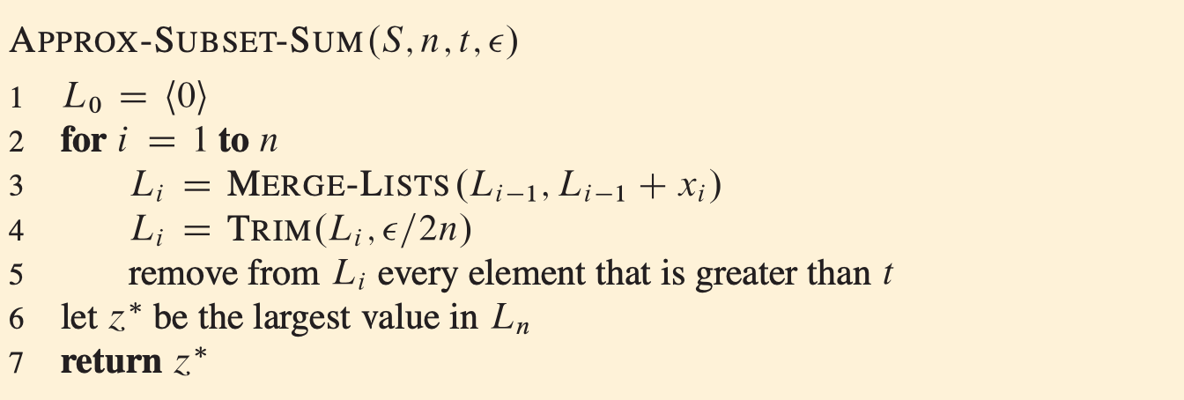
Fully polynomial-time approximation scheme
The algorithm
The algorithm is similar to our exponential algorithm except we now perform a trim step.

Slide 13
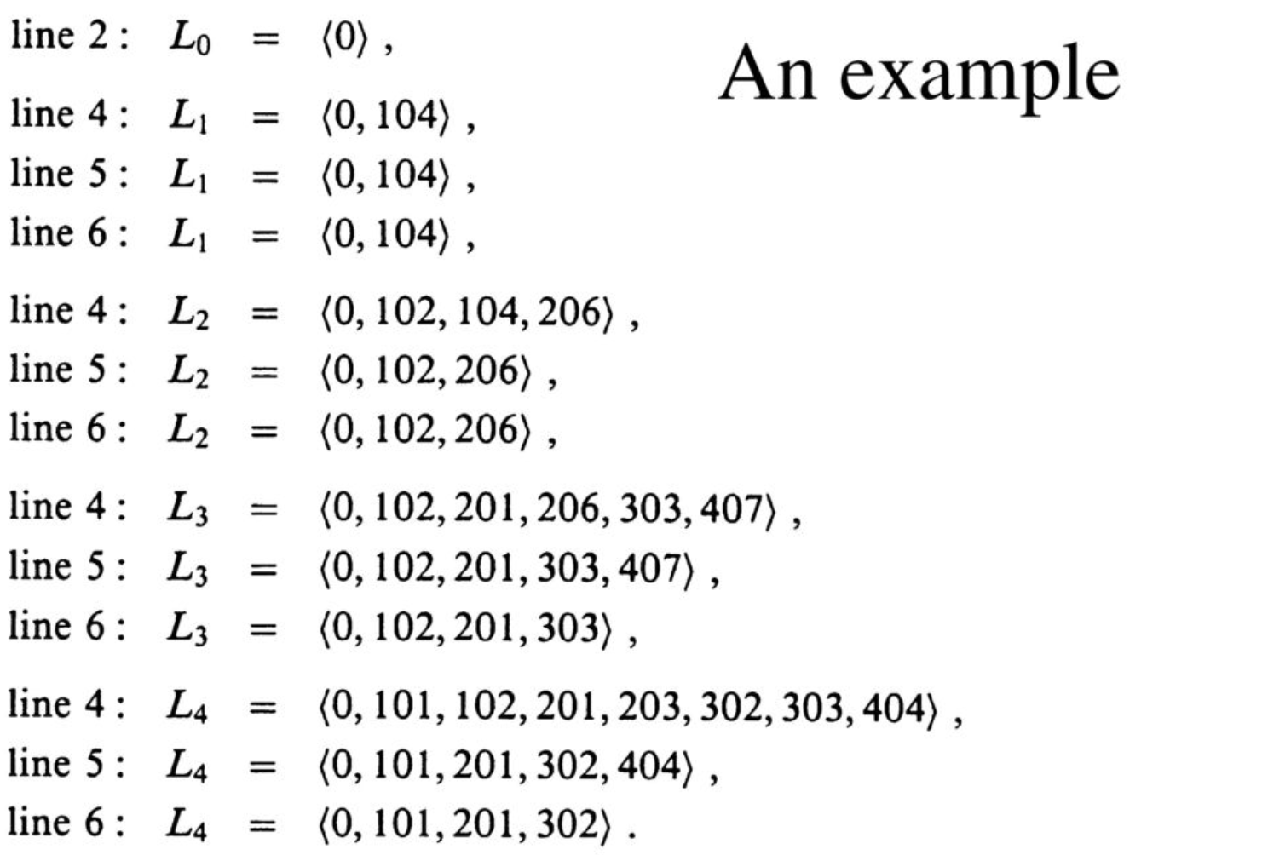

Fully polynomial-time approximation scheme
An example
As example, given S = (104, 102, 201, 101) with t=308 and $ε=0.4$.
The trimming parameter $δ$ is $\frac{ε}{2n}=\frac{0.40}{8}=0.05$.
The algorithm returns z=302 as its answer, which is well within $ε=40\%$ of the optimal answer 307 (104+102+101).
In fact, it is within 2%

Slide 14
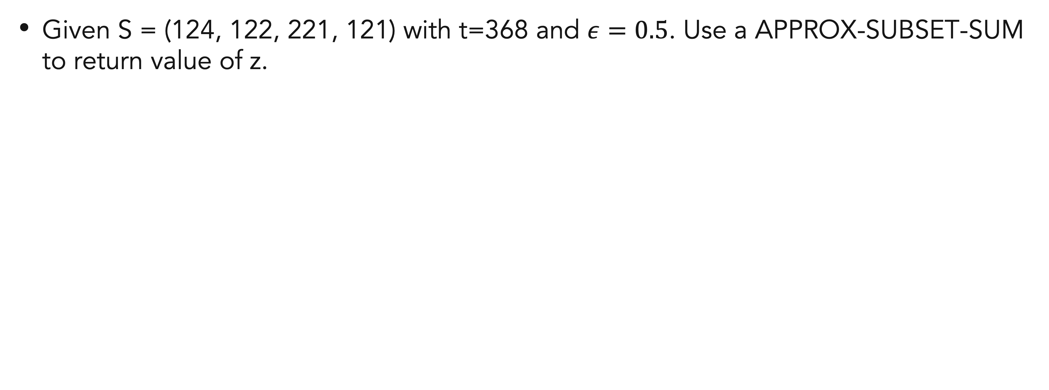
Exercises
25
Given S = (124, 122, 221, 121) with t=368 and $ε=0.5$. Use a APPROX-SUBSET-SUM to return value of z.

Slide 15
References
Thomas H. Cormen. (2022). Introduction to algorithms: Fourth edition. The MIT Press. Chapter 35.
https://www.win.tue.nl/~kbuchin/teaching/2IL15/Slides/AlgorithmsLecture_11.pdf

Slide 16
Thank you
Approximation Algorithms: Subset-sum
September, 2023

